Slide 1




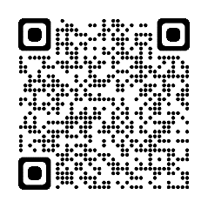
The BRAVE BRG and the Marine Corps Reserve are collecting
NEW AND UNWRAPPED TOYS in support of the
Marine Corps Toys for Tots Foundation
Toys can be dropped off at: A Lobby, A Café, E Lobby, B Lobby, and C Lobby at Creve Coeur OR AA café, CC2 entry, and FF4 atrium at Chesterfield starting November 21st.
You may also make your toy donation at the Holiday Breakfasts!
December 10th in Chesterfield
December 11th in Creve Coeur
Thanks for donating and for making this holiday season brighter!
Make a Difference in a Child’s Life
Donate a New & Unwrapped Toy!
For questions regarding toy collection, please contact Katie Lyons (314-370-3148 or kathryn.lyons@bayer.com)
Want to make a Monetary Donation? Please use this QR Code!

